Slide 1
Exploring Chintamani
A Cultural and Agricultural Hub

Slide 2
Introduction
Chintamani is a town in Karnataka, India, known for its agricultural significance, serene landscapes, and cultural heritage. It is a vital economic and cultural center.

Slide 3
Historical Background
The name 'Chintamani' is rooted in cultural significance. Over the centuries, it has grown as a center of trade, agriculture, and tradition, influenced by various rulers.

Slide 4
Geographical Significance
Location: Chikkaballapur District, Karnataka.
Proximity: ~70 km from Bangalore.
Climate: Semi-arid, suitable for agriculture.
Topography: Features hills and fertile plains.

Slide 5
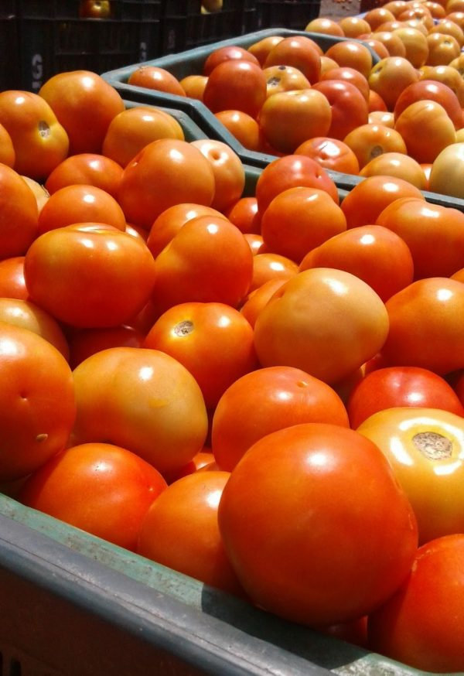
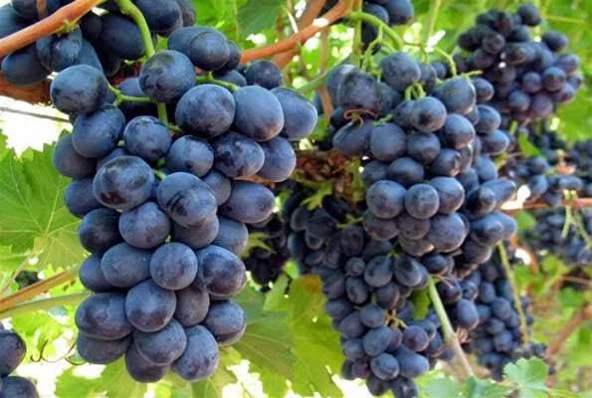
Economy and Agriculture
Chintamani is a key agricultural hub in Karnataka. Major crops include:
- Silk
- Grapes
- Tomatoes
- Flowers
The town's markets are known for vibrant trade activities.

Slide 6

Tourist Attractions
Chintamani has various attractions, including:
- Religious sites (temples, dargahs).
- Natural attractions (hills, lakes).
- Nearby points of interest: Nandi Hills, Skandagiri.

Slide 7
Conclusion
Chintamani stands out for its rich agricultural economy, cultural traditions, and scenic beauty. It is a unique blend of history and modern development.
Thank you

